Slide 1
Is saving money always a good thing
Zhiyang Wu
2023-03-28

Slide 2

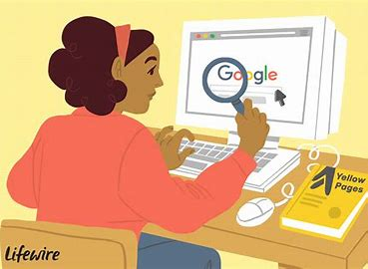
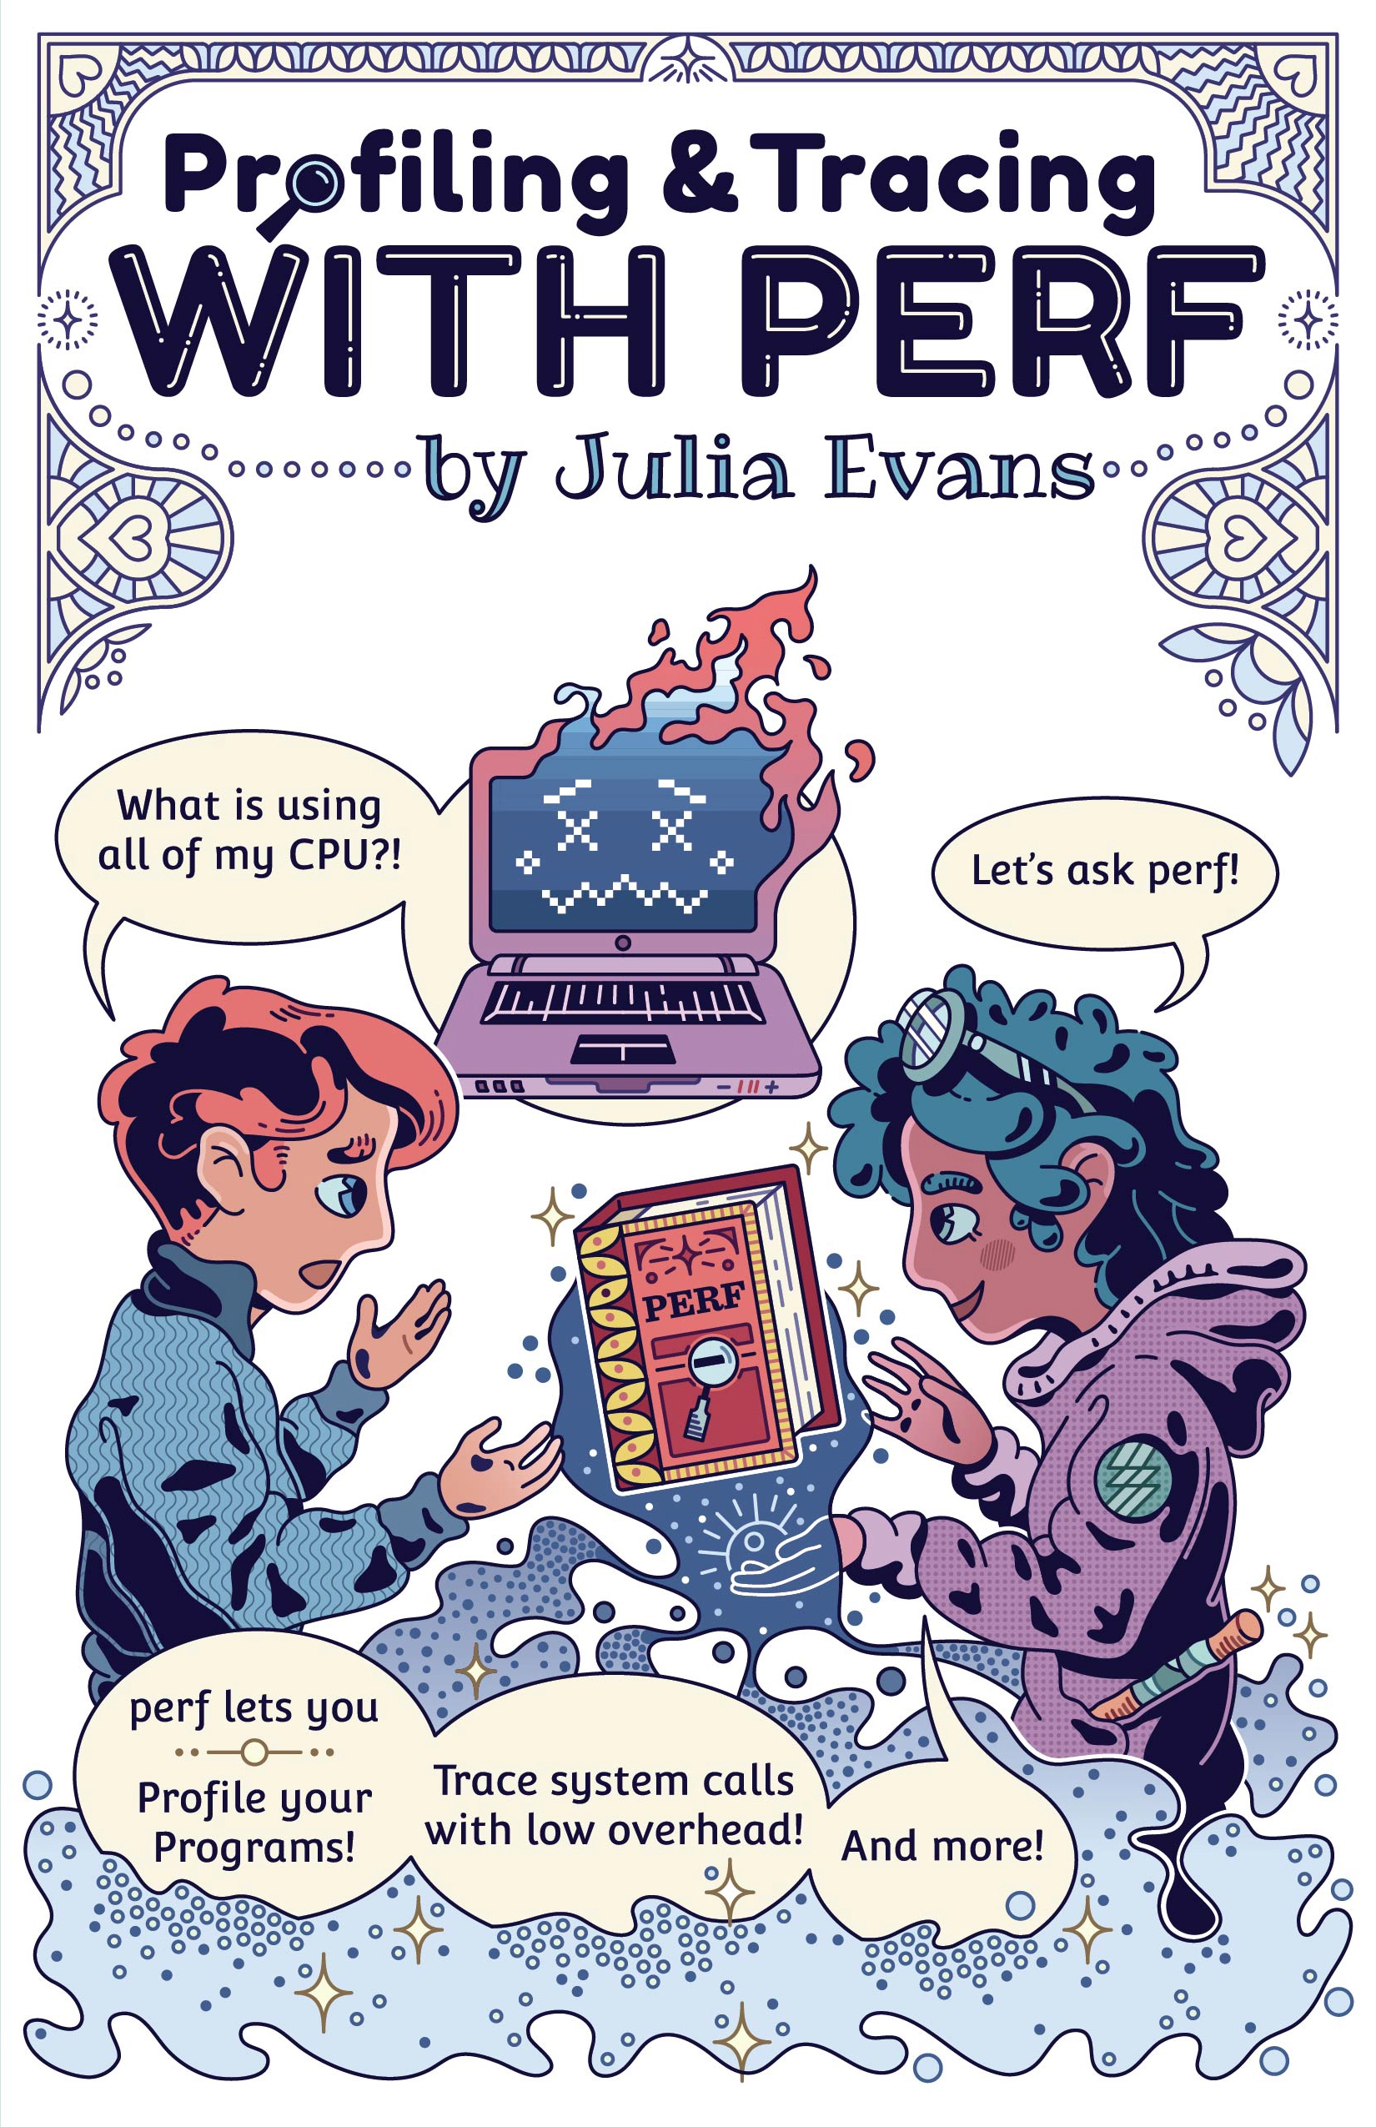

Question
If we ignore the copyright problems
Notes:
Would you search the internet for hours to find a free copy of this wonderful book, or would you just go to this website and buy it
I used to be the searching way but after I read an economics book I changed
Now I will buy it directly

Slide 3


Opportunity Cost vs Money
Notes:
We were always told to save money, but sometimes we neglect the opportunity cost
blindly saving money without considering the opportunity cost or sacrificing important aspects of our lives like our time or health can be detrimental.
So, it's important to strike a balance and approach saving money in a thoughtful and intentional way.

Slide 4



Example 1: Find someone or do it yourself
Time
Money
Notes:
Firstly, let's talk about time. Time is a valuable resource that we can never get back once it's gone. Many people try to save money by doing things themselves instead of hiring a professional, such as fixing their own plumbing or doing their own taxes. However, these tasks can be time-consuming.
For example, if someone spends several hours fixing their own plumbing, they may have saved money on a plumber's fee, but they have also lost valuable time that could have been spent on earning more money or enjoying leisure activities. Therefore, it's important to consider the opportunity cost of saving money in this situation.

Slide 5
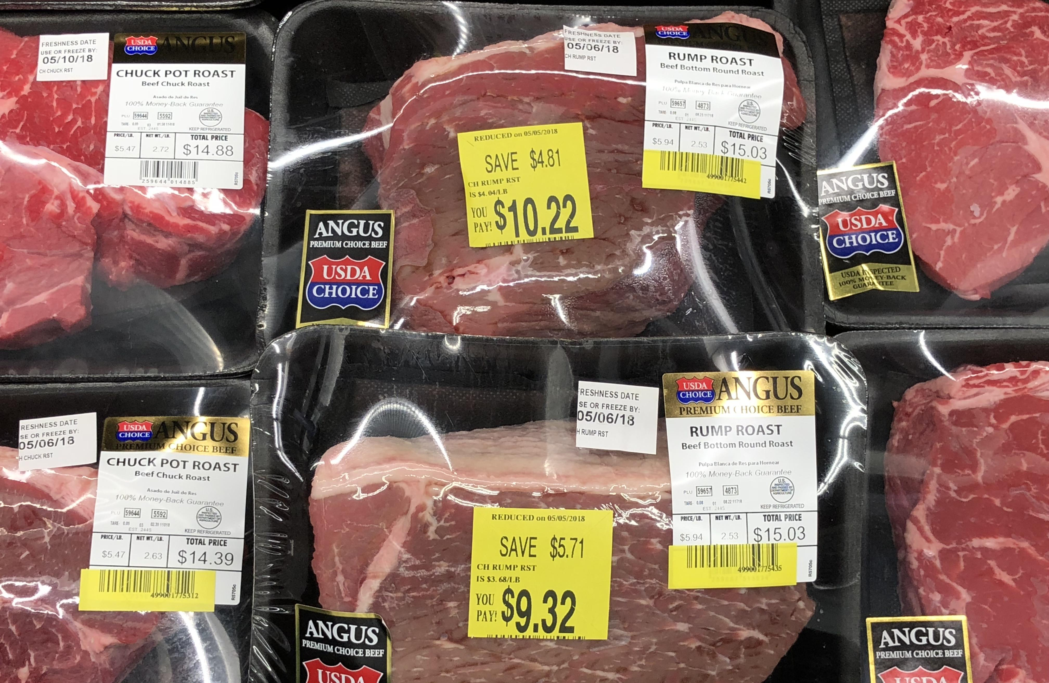


Example 2: Discount or Fresh
Notes:
Another reason why saving money may not always be a good thing is that it can negatively affect our quality of life.
For instance, consider someone who tries to save money by eating unhealthy, low-quality food or by not seeking necessary medical treatment. In the short term, this might save them money, but in the long term, it can lead to health problems that are much more expensive and damaging to their overall well-being.

Slide 6
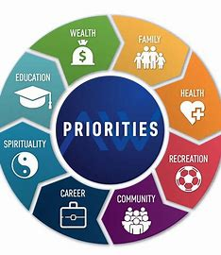

Conclusion
Notes:
In conclusion, while saving money is important, it's not always a good thing if it means sacrificing our time or quality of life.
We should strive to find a balance between saving money and investing in our well-being and find ways to save money that align with our values and priorities. By doing so, we can make better financial decisions and ultimately live a more fulfilling life.

Slide 7
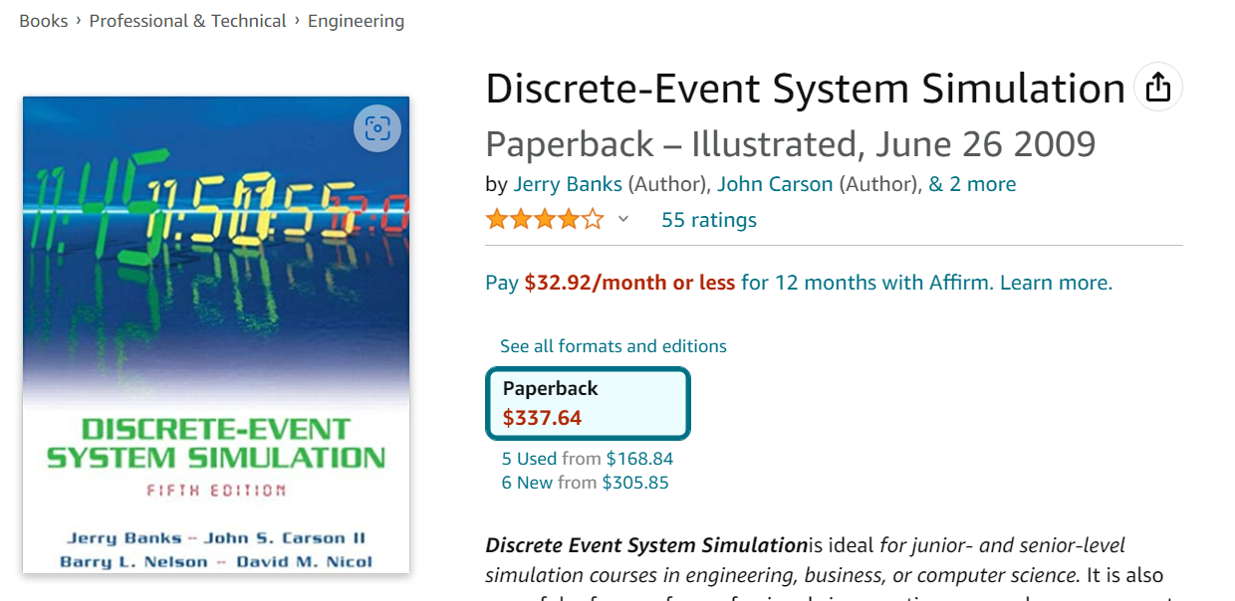
Open Question
Notes:
After my presentation will you buy this book, if it is necessary for one of your courses or you will search the free internet version?
For me, If I have to buy this book otherwise I can’t engage in the course, I will drop this course

Slide 8
THE END
THANKS

